Slide 1

ESC101: Introduction to Computing
Pointers

Slide 2
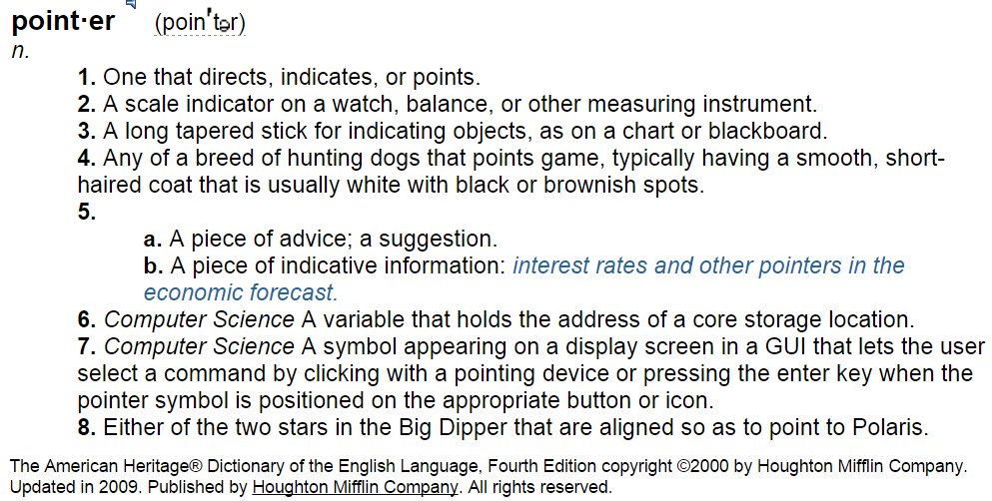
Pointer: Dictionary Definition

Slide 3

Pointer we are all born with

Slide 4
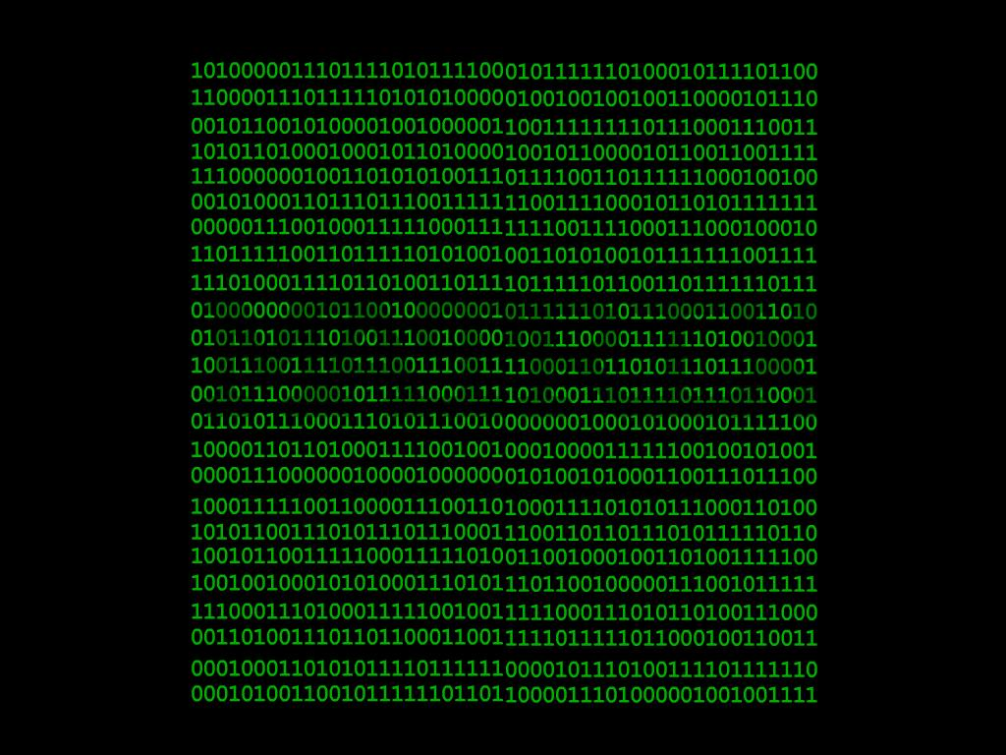
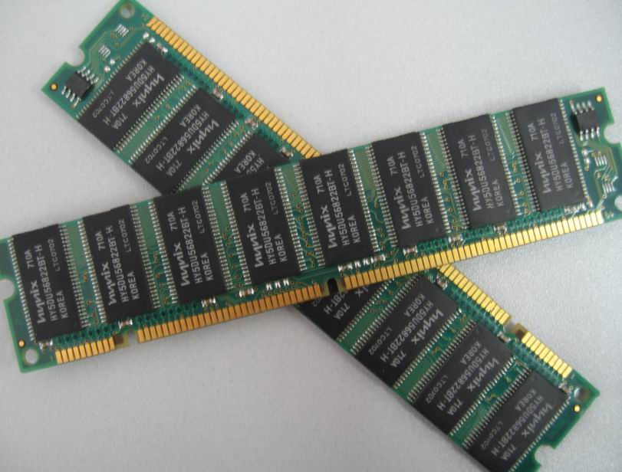

Slide 5
Simplified View of Memory
“Array” of blocks
Each block can hold a byte (8-bits)
“char” stored in 1 block
“int” (32-bit) stored in 4 consecutive blocks
Finite number of blocks
  Limited by the capacity of (Virtual) Memory
  Blocks are addressable – [0…2^{N}-1]
1004000
1004001
1004002
1004003
1004004
1004005
1004006
1004007
1004008
1004009
1004010
1004011
1004012
1004013
1004014
1004015
‘A’
‘E’
‘I’
‘O’
‘U’
1024
1004001

Slide 6
Simplified View of Memory
  Blocks are addressable.
  Address range: [0…2^{N}-1]
  N is the number of bits in address (number of digits in binary world)
  Any integer in the above range
    Can be used as an index in the MEMORY ARRAY
  Since memory array is unique, we can use this index alone
    If context is clear
1004000
1004001
1004002
1004003
1004004
1004005
1004006
1004007
1004008
1004009
1004010
1004011
1004012
1004013
1004014
1004015
‘A’
‘E’
‘I’
‘O’
‘U’
1024
1004001

Slide 7
Simplified View of Memory
1004000
1004001
1004002
1004003
1004004
1004005
1004006
1004007
1004008
1004009
1004010
1004011
1004012
1004013
1004014
1004015
‘A’
‘E’
‘I’
‘O’
‘U’
1024
1004001
Content of the 4-blocks starting at address 1004012
  1004001
Without knowing the context it is not possible to determine the significance of number 1004001
  It could be an integer value 1004001
  It could be the “location” of the block that stores ‘E’
“Type” helps us
disambiguate.
How do we decide what it is?

Slide 8
What is a Pointer
Pointer: A special type of variable that contains an address of a memory location.
Think of a pointer as a new data type (a new kind of box) that holds memory addresses.
Pointers are almost always associated with the type of data that is contained in the memory location.
  For example, an integer pointer is a memory location that contains an integer.
  Character pointer, float pointer
  Even pointer to pointer (more on this later …)

Slide 9

too
much theory.
Give
examples
please
Banti
OK.
Let me take you on a
journey of Pointers in
SEA
SEA C
Owlie

Slide 10

Remember Arrays?
The memory allocated to array has two components:
A consecutively allocated segment of memory boxes of the same type, and
A box with the same name as the array. This box holds the address of the base (i.e., first ) element of the array.
int num[10];
num
num[0]
num[1]
num[2]
num[9]
This definition for num[10] gives 11 boxes, 10 of type int, and 1 of type address of an int box.
Hmm…
We represent the address of a box x by an arrow to the box x. So addresses are referred to as pointers.
The contents of an address box is a pointer to the box whose address it contains. e.g., num points to num[0] above.

Slide 11

What can we do with a box? e.g., an integer box?
That’s simple. We can do operations that are supported for the data type of the box.
int num[10];
True!. But we can also take the address of a box.We do this when we use scanf for reading using the & operator.
For integers, we can do + - * / % etc. for each of num[0] through num[9].
OK. Say i want to take the address of num[1] and store it in an address variable ptr.
ptr = &num[1];
ptr would be of type address of int. In C this type is int *.
But what is the type of ptr? And how do i define ptr?
int * ptr;
ptr= &num[1];

Slide 12
To see the meaning of ptr =&num[1], let’s look at the memory state.
int num[10];
int * ptr;
ptr = &num[1];
Here is the state after int num[10] gets defined.
OK, ptr is of type pointer to integer. But what does
mean?
num
num[0]
ptr = &num[1];
num[1]
num[2]
num[9]
ptr
The statement creates a new box of type “address of an int box”, more commonly referred to as, of type “pointer to integer”.
int *ptr;
The statement assigns to ptr the address of the box num[1]. Commonly referred to as: ptr now points to num[1].
ptr = &num[1];

Slide 13
OK, i see. The program fragment below results in this memory state.
int num[10];
int * ptr;
ptr = &num[1];
num
num
[0]
num[1]
num[2]
num[9]
5
ptr
question
Yes! scanf(“%d”,ptr) reads input integer into the box pointed to by the corresponding argument.
The box pointed to by ptr is num[1].
So num[1] becomes 5.
Suppose I now add the following statement after above fragment
scanf(“%d”,ptr);
Input
and input is :
5
Does num[1] become 5?

Slide 14
num
num
[0]
num[1]
num[2]
num[9]
5
Well, what else can you do
with ptr?
ptr
num is of type int [] (i.e., array of int). In C the box num stores the pointer to num[0]. Internally, C represents num and ptr in the same way. So the type int * can be used wherever int[] can be used.
What’s so interesting? Please give examples.
Here are the interesting parts! You can
de-reference the pointer.
do simple arithmetic + - with pointers.
compare pointers and test for ==, <, > etc., similar to ordinary integers.

Slide 15
10
num
num
[0]
num[1]
num[2]
num[3]
num[4]
num[9]
5
ptr
De-referencing a pointer ptr gives the box pointed to by ptr. The de-referencing operator in C is also *.
Hmm…
printf(“%d”, *ptr);
Output
5
Since ptr points to num[1], *ptr is the box num[1]. Printing it gives the output 5.
Consider statement
*ptr = *ptr + 5;
This will add 5 to the value in box pointed by ptr. So num[1] will become 5+5 = 10

Slide 16
15
22
num
num
[0]
num[1]
num[2]
num[3]
num[4]
num[9]
1
10
7
-1
61
ptr
Recall rule about pointers:
De-referencing a pointer ptr gives the box pointed to by ptr. The de-referencing operator in C is *.
Consider the statements. Execute them on above memory state.
*ptr = *ptr + 5;
num[2] = num[1]+num[2];
OK…
1st statement will add 5 to the value in box pointed by ptr. So *ptr becomes 10 + 5 = 15.
But *ptr and num[1] are the same box. So 2nd statement assigns 15 + 7 equals 22 to num[2].

Slide 17
num
num[0]
num[1]
num[2]
num[9]
15
22
Hmm…
seems
legal—
‘cause
1
16
Consider the
statement
ptr
num can be thought to be of type int *, and, ptr is of type int *.
So *num is of type int, which is 1 and *ptr is of type int with value 15
So num[2] is set to 16.
num[2]= *num + *ptr;
Is it a legal statement?
What would be the result?

Slide 18
Let me show you some cool stuff: pointer arithmetic.
Let
int num[] = {1,22,16,-1,23};
num[0]
num[1]
num[2]
num[3]
num[4]
1
22
16
-1
23
num
num+1 points to integer box just next to the integer box pointed to by num. Since arrays were consecutively allocated, the integer box just next to num[0] is num[1].
Okay,
What’s
cool?
So num+1 points to num[1]. Similarly, num+2 points to num[2], num + 3 points to num[3], and so on.
Can you tell me the output of this printf statement?
Hmm…
Output
would
be
printf(“%d %d %d”, *(num+1),
*(num+2),*(num+3));
22 16 -1

Slide 19
Let us predict the output of
some simple code fragments.
owlie
char str[] =“BANTI is a nice girl”;
char *ptr = str + 6; /*initialize*/
printf(“%s”,ptr);
What is printed by the above program?
First let us draw the state of memory.
str[0]
str[5]
str[10]
str[15]
‘B’
‘A’
‘N’
‘T’
‘I’
‘i’
‘s’
‘ ’
‘a’
‘ ’
‘n’
‘i’
‘c’
‘e’
‘ ’
str
ptr
‘g’
‘i’
‘r’
‘l’
‘\0’
str[16]
str[20]
ptr points to str[6]. printf prints
the string starting from str[6], which is
Hmm…
OK
Output
is a nice girl

Slide 20
OK. Let me understand.The char array str[] was initialized as below.
str + 5
char str[] = “BANTI is a nice girl”;
char *ptr; ptr = str + 6;
str is of type
char *. So str + 6 points to the 6th character from the character pointed to by str. That is ptr. Correct?
str
‘B’
‘A’
‘N’
‘T’
‘I’
‘ ’
str + 10
equals ptr +4
‘i’
‘s’
‘ ’
‘a’
‘ ’
‘n’
ptr
str + 18
‘i’
‘c’
‘e’
‘ ’
‘g’
‘i’
str + 23
Here are some other pointer expressions-are they correct?
‘r’
‘l’
‘\0’
--
--
--
expressions with pointers
Yes,
that’s
correct
Yes, they’re all correct. Can you tell me the output of:
Hmm… I’m thinking
printf(“%s”,ptr-5);

Slide 21
char str[] = “BANTI is a nice girl”;
char *ptr; ptr = str + 6;
printf(“%s”,ptr-5);
ptr -5 should point to the 5th char backwards from the char pointed to by ptr. So ptr-5 points here
str
‘B’
‘A’
‘N’
‘T’
‘I’
‘ ’
‘i’
‘s’
‘ ’
‘a’
‘ ’
‘n’
ptr
The string starting from this point is “ANTI is a nice girl”. That would be the output. Correct?
‘i’
‘c’
‘e’
‘ ’
‘g’
‘i’
‘r’
‘l’
‘\0’
--
--
--
Output
ANTI is a nice girl
Yes,
that’s
correct

Slide 22
Pointers play an important role when used as parameters in function calls.
OK.
How
so?
Let’s start with the old example.
int main() {
int a = 1, b = 2;
swap(a,b);
printf(“From main”);
printf(“a = %d”,a);
printf(“b=%d\n”,b);
}
void swap(int a, int b) {
int t;
t = a; a=b; b =t;
printf(“From swap”);
printf(“a = %d”,a);
printf(“b= %d\n”,b);
}
The swap(int a, int b) function is intended to swap (exchange) the values of a and b.
Could you
explain again? i’m not so sure
But, if you remember, the value of a and b do not change in main(), although they are swapped in swap().
OK, let’s first
trace the call to swap

Slide 23
int main() {
int a = 1, b = 2;
swap(a,b);
printf(“From main”);
printf(“ a = %d”,a);
printf(“b = %d”,b);
}
void swap(int a, int b) {
int t;
t = a; a=b; b =t;
printf(“From swap ”);
printf(“a= %d”,a);
printf(“b= %d\n”,b);
}
a
1
Output:
From swap a= 2 b= 1
STACK
b
2
Now swap() returns:
Return address is line 3 of main(). Program counter is set to this location.
Stack for swap() is deleted.
main()
return
address
swap()
main.3
a
2
1
1
t
b
1
2

Slide 24

int main() {
int a = 1, b = 2;
swap(a,b);
printf(“From main”);
printf(“ a = %d”,a);
printf(“b = %d”,b);
}
void swap(int a, int b) {
int t;
t = a; a=b; b =t;
printf(“From swap ”);
printf(“a = %d”,a);
printf(“b = %d\n”,b);
}
Output:
From swap a = 2 b = 1
a
1
Hmm…
STACK
b
2
Returning back to main(),we resume execution from line 3.
main()
But the variables a and b of main() are unchanged from what they were before the call to swap(). They are printed as is.
Changes made by swap() remained local to the variables of swap(). They did not propagate back to main().

Slide 25
int main() {
int a = 1, b = 2;
swap(a,b);
printf(“From main”);
printf(“ a = %d”,a);
printf(“b = %d”,b);
}
void swap(int a, int b) {
int t;
t = a; a=b; b =t;
printf(“From swap ”);
printf(“a = %d”,a);
printf(“b = %d\n”,b);
}
Output:
From swap a = 2 b = 1
OK, i
remember
now
a
1
From main a = 1 b = 2
b
2
Passing int/float/char as parameters does not allow passing “back” to calling function.
Any changes made to these variables are lost once the function returns.
Pointers will help us solve this problem!

Slide 26
Here is the changed program.
void
swap(int *ptra, int *ptrb)
{
int t;
t = *ptra;
*ptra= *ptrb;
*ptrb =t;
}
int main() {
int a = 1, b = 2;
swap(&a, &b);
printf(“a=%d, b=%d”,
a, b);
return 0;
}
The function swap() uses pointer to integer arguments, int *ptra and int *ptrb.
The main() function calls swap(&a,&b), i.e., passes the addresses of the ints it wishes to swap.

Slide 27
Tracing the swap function
int main() {
int a = 1, b = 2;
swap(&a, &b);
}
1
2
a
b
&a
&b
Address of a. (a is situated at memory location 0x1024)
0x1024
0x2000

Slide 28
void swap(int *ptra, int *ptrb) {
int t;
t = *ptra;
*ptra= *ptrb;
*ptrb =t;
}
a
b
1
2
2
1
1
2
0x1024
0x2000
&a
&b
main
2
swap
0x1024
0x2000
ptra
ptrb
t

Slide 29
Homework ☺
Will the following code perform swap correctly?
a
b
void swap(int *ptra, int *ptrb) {
int *ptrt;
ptrt = ptra;
ptra= ptrb;
ptrb =ptrt;
}
1
2
0x1024
0x2000
&a
&b
0x1024
0x2000
ptra
ptrb
t

Slide 30
Simplified View of Memory: Recap
Give
examples
please
1004000
1004001
1004002
1004003
1004004
1004005
1004006
1004007
1004008
1004009
1004010
1004011
1004012
1004013
1004014
1004015
‘A’
‘E’
‘I’
‘O’
‘U’
1024
1004001
Content of the 4-blocks starting at address 1004012
  1004001
Without knowing the context it is not possible to determine the significance of number 1004001
  It could be an integer value 1004001
  It could be the “location” of the block that stores ‘E’
“Type” helps us
disambiguate.
How do we decide what it is?

Slide 31
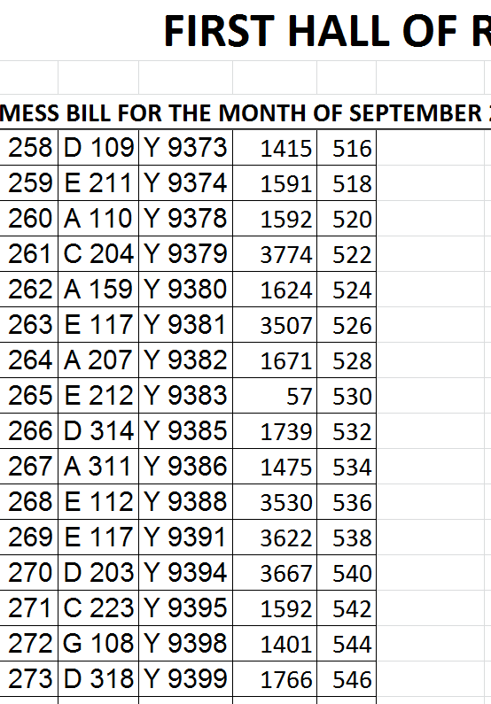
Suppose there is a
BIIIIIIG Hostel:
26 wings, 10000 rooms in each wing.
What does Y 9391 represents in such a hostel ?
“Type” helps us
disambiguate.
Type = column header
Room
Address
Roll Number

Slide 32
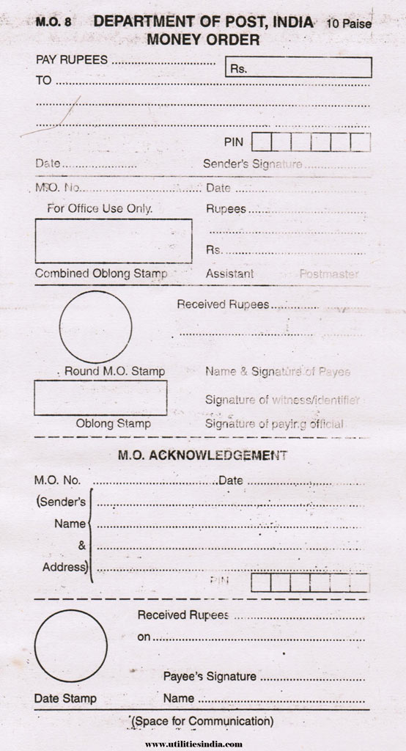
String 1: Address of the recipient
String 2: Message from sender to recipient
Sender can send own address in String 2, but it is still treated as message
Postman doesn’t get confused (generally ☺)
String 1
“Type” helps us disambiguate.
Type = space where we write the address
String 2

Slide 33
Simplified View of Memory
1004000
1004001
1004002
1004003
1004004
1004005
1004006
1004007
1004008
1004009
1004010
1004011
1004012
1004013
1004014
1004015
‘A’
‘E’
‘I’
‘O’
‘U’
1024
1004001
x
In programming also, “Type” helps us decide whether 1004001 is an integer or a pointer to block containing ‘E’ (or something else)
#include<stdio.h>
int main() {
char x[5] = {‘A', ‘E', ‘I', ‘O', ‘U'};
int y = 1024;
char *p = x+1;
…
}
y
#include<stdio.h>
int main() {
char x[5] = {‘A', ‘E', ‘I', ‘O', ‘U'};
int y = 1024;
int p = 1004001;
…
}
Declaration of a pointer to char box
p

Slide 34
Pointers: Visual Representation
Typically represented by box and arrow diagram
45FD
53
x is an int variable that contains the value 53.
Address of x is 45FD.
px is a pointer to int that contains address of x.
8CF2
45FD
px
x
839B
‘H’
y is an char variable that contains the character ‘H’.
Address of y is 839B.
py is a pointer to char that contains address of y.
8BF9
839B
py
y
We are showing addresses for explanation only.
Ideally, the program should not depend on actual addresses.

Slide 35
Pointer to a pointer
If we have a pointer P to some memory cell, P is also stored somewhere in the memory.
So, we can also talk about address of block that stores P.
B4F7
45FD
53
8BF9
B4F7
45FD
ppx
px
x
We are showing addresses for explanation only.
Ideally, the program should not depend on actual addresses.
int x = 53;
int *px = &x;
int **ppx = &px;

Slide 36
Size of Datatypes
The smallest unit of data in your computer's memory is one bit. A bit is either 0 or 1.
8 bits make up a byte.
2¹⁰ bytes is 1 kilobyte (KB). 2¹⁰ KB is 1 megabyte (MB). 2¹⁰ MB is 1 gigabyte (GB).
Every data type occupies a fixed amount space in your computer's memory.

Slide 37
Size of Datatypes
There is an operator in C that takes as argument the name of a data type and returns the number of bytes the data type takes
  the sizeof operator.
For example, sizeof(int) return the number of bytes a variable of type int uses up in your computer’s memory.

Slide 38
sizeof Examples
printf("int: %d\n", sizeof(int));
printf("float: %d\n", sizeof(float));
printf("long int: %d\n", sizeof(long int));
printf("double: %d\n", sizeof(double));
printf("char: %d\n", sizeof(char));
printf("int ptr: %d\n", sizeof(int *));
printf("double ptr: %d\n", sizeof(double*));
printf("char ptr: %d\n", sizeof(char *));
int: 4
float: 4
long int: 8
double: 8
char: 1
int ptr: 8
double ptr: 8
char ptr: 8
The values can vary from computer to computer.
Note that all pointer types occupy the same number of bytes (8 bytes in this case).
  Depends only on total # of memory blocks (RAM/Virtual Memory) and not on data type

Slide 39
Static Memory Allocation
When we declare an array, size has to be specified before hand
During compilation, the C compiler knows how much space to allocate to the program
  Space for each variable.
  Space for an array depending on the size.
This memory is allocated in a part of the memory known as the stack.
Need to assume worst case scenario
  May result in wastage of Memory

Slide 40
Dynamic Memory Allocation
There is way of allocating memory to a program during runtime.
This is known as dynamic memory allocation.
Dynamic allocation is done in a part of the memory called the heap.
You can control the memory allocated depending on the actual input(s)
  Less wastage

Slide 41
Memory allocation: malloc
The malloc function is declared in
  stdlib.h
Takes as argument an integer (say n, typically > 0),
Allocates n consecutive bytes of memory space, and
returns the address of the first cell of this memory space
The return type is void*
WAIT!! Doesn’t void means “nothing” in C?
What is the meaning of void*? Pointer to nothing!

Slide 42

void* is NOT pointer to nothing!
malloc knows nothing about the use of the memory blocks it has allocated
void* is used to convey this message
  Does not mean pointer to nothing, but means pointer to something about which nothing is known
The blocks allocated by malloc can be used to store “anything” provided we allocate enough of them

Slide 43
malloc: Example
A pointer to float
float *f;
f= (float*) malloc(10 * sizeof(float));
Size big enough to hold 10 floats.
Explicit type casting to convey users intent
Note the use of sizeof to keep it machine independent
malloc evaluates its arguments at runtime to allocate (reserve) space. Returns a void*, pointer to first address of allocated space.

Slide 44
malloc: Example
Key Point: The size argument can be a variable or non-constant expression!
After memory is allocated, pointer variable behaves as if it is an array!
float *f; int n;
scanf(“%d”, &n);
f= (float*) malloc(n * sizeof(float));
f[0] = 0.52;
scanf(“%f”, &f[3]); // OOB if n<=3
printf(“%f”, *f + f[0]);

Slide 45
Exercise
Write a program that reads two integers, n and m, and stores powers of n from 0 up to m (n⁰, n¹, …, n^{m})
#include<stdio.h>
#include<stdlib.h>
int main(){
int *pow, i, n, m;
scanf("%d %d", &n, &m); // m>= 0
pow = (int *) malloc ((m+1) * sizeof(int));
pow[0] = 1;
for (i=1; i<=m; i++)
pow[i] = pow[i-1]*n;
for (i=0; i<=m; i++)
printf("%d\n",pow[i]);
return 0;
}
Note that instead of writing pow[i], we can also write
*(pow + i)

Slide 46
NULL
A special pointer value to denote “points-to-nothing”
C uses the value 0 or name NULL
In Boolean context, NULL is equivalent to false, any other pointer value is equivalent to true
A malloc call can return NULL if it is not possible to satisfy memory request
  negative or ZERO size argument
  TOO BIG size argument

Slide 47
Pointers and Initialization
Uninitialized pointer has GARBAGE value, NOT NULL
Memory returned by malloc is not initialized.
Brothers of malloc
  calloc(n, size): allocates memory for n-element array of size bytes each. Memory is initialized to ZERO.
  realloc(ptr, size): changes the size of the memory block pointed to by ptr to size bytes.
    Complicated semantics, try to avoid.

Slide 48
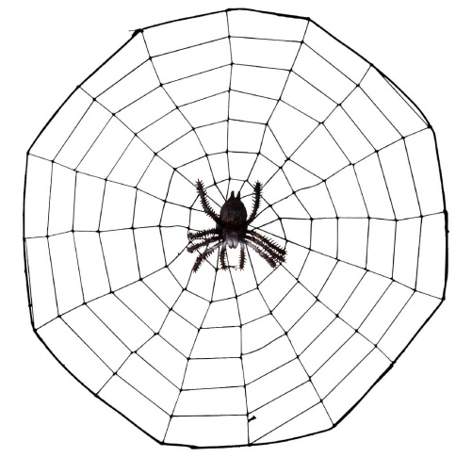
With great power comes great responsibility
Power to allocate memory when needed must be complimented by the responsibility to de-allocate memory when no longer needed!
  free unused pointers
Be prepared to face rejection of demand
  Check the return value of malloc (and its variants)

Slide 49

Typical dynamic allocation
int *ar;
…
ar = (int*) malloc(…);
if (ar == NULL) { // $≡$if (!ar)
// take corrective measures OR
// return failure
}
…
…ar[i]… // use of ar
…
free(ar); // free after last use of ar

Slide 50

Dynamic memory management is similar to library management

Slide 51

Pointer Declaration = Registration
int *ar;
Declare your intent that you will use books from the library

Slide 52

malloc = check out
Reserve book(s) for your use
ar = (int*) malloc(…);

Slide 53
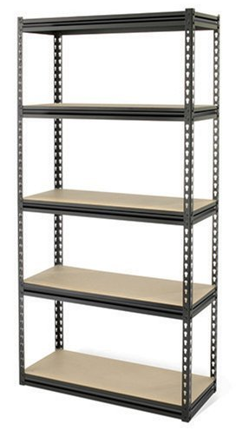
What if the book is not available?
if (ar == NULL) {
// take corrective measures
// OR return failure
}
Book not available: Purchase the book?
Share with a friend?
Not study ☹

Slide 54

If the check out is successful
…ar[i]… // use of ar
Read it.

Slide 55


If the check out is successful
br = ar; // copy the address
…
ar[i] = …; // change the content
…
br[i] = …; // change the content indirectly
…
Share it.
Write on book (Not a good practice)

Slide 56
If the check out is successful
// Do nothing –
// Just hog the resources
Show off B-)

Slide 57

free = return the book
free(ar); // free after last use of
// alloc’ed memory
Your job is done, return the book so that others can use it.

Slide 58
Return the book
br = ar;
…
free(br); // free after last use
free(ar); // multiple free of same loc not allowed
Your friend can also return the book for you.
But a book can be returned only once per check out!

Slide 59

Arrays and Pointers
In C, array names are nothing but pointers.
  Can be used interchangeably in most cases
However, array names can not be assigned, but pointer variables can be.
int ar[10], *b;
ar = ar + 2;
ar = b;
b = ar;
b = b + 1;
b = ar + 2;
b++;

Slide 60

Precedence (Refined)
( ) [ ]
LR
* (deref) ++ --
! & + -
RL
* / %
LR
+ -
LR
< <= > >=
LR
== !=
LR
&&
||
LR
LR
=
RL
,
LR

Slide 61
Array of Pointers
Consider the following declaration
int *arr[10];
arr is a 10-sized array of pointers to integers
How can we have equivalent dynamic array?
int **arr;
arr = malloc ( );
(int **)
10 *
sizeof(int *)

Slide 62
Array of Pointers
int **arr;
arr = malloc ( );
(int **)
10 *
sizeof(int *)
Note that individual elements in the array arr (arr[0], … arr[9]) are NOT allocated any space. Uninitialized.
We need to do it (directly or indirectly) before using them.
int j;
for (j = 0; j < 10; j++)
arr[j] = (int*) malloc (sizeof(int));

Slide 63
Exercise: All Substrings
Read a string and create an array containing all its substrings.
Display the substrings.
Input: ESC
Output:
E
ES
ESC
S
SC
C

Slide 64
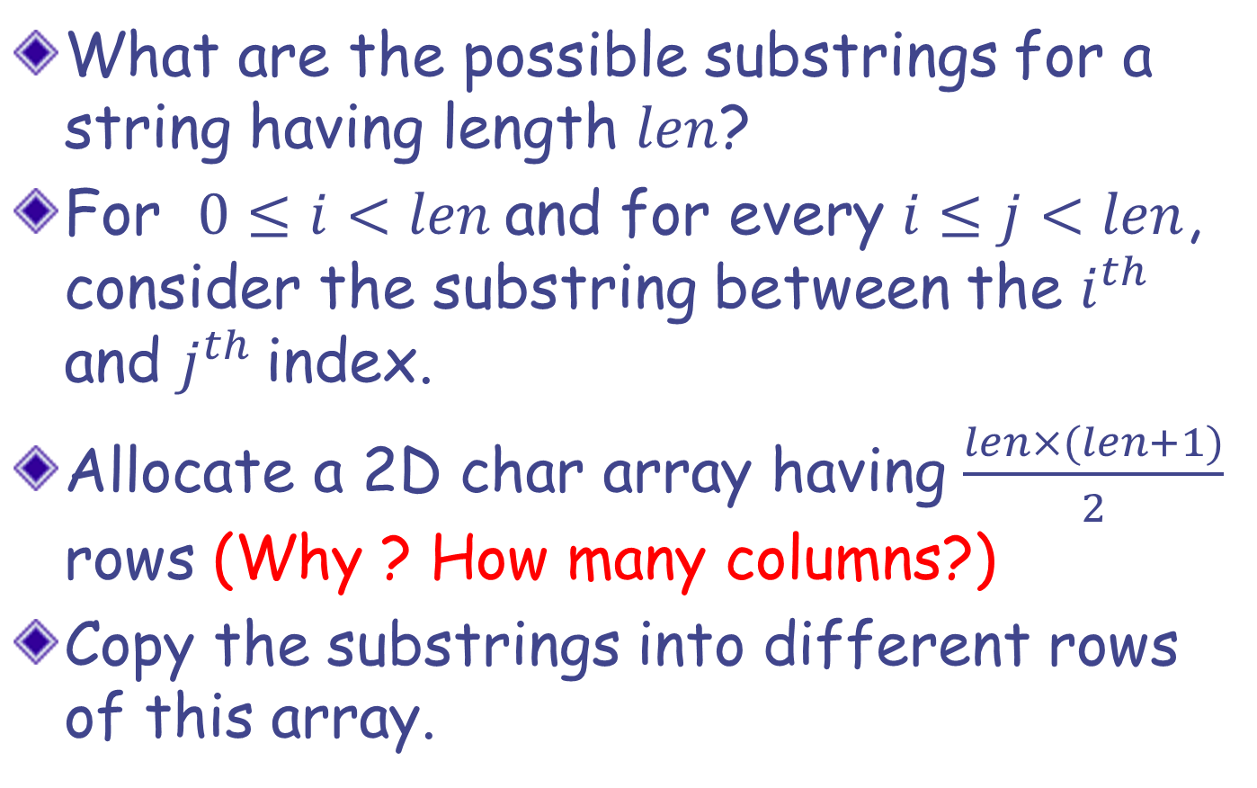
All Substrings: Solution Strategy
What are the possible substrings for a string having length $len$?
For $0≤i<len$and for every $i≤j<len$, consider the substring between the $i^{th}$ and $j^{th}$index.
Allocate a 2D char array having $\frac{len×(len+1)}{2}$ rows (Why ? How many columns?)
Copy the substrings into different rows of this array.

Slide 65
Solution: Version 1
int len, i, j, k=0, nsubstr;
char st[100], **substrs;
scanf("%s",st);
len = strlen(st);
nsubstr = len*(len+1)/2;
substrs = (char**)malloc(sizeof(char*) * nsubstr);
for (i=0; i<nsubstr; i++)
substrs[i] = (char*)malloc(sizeof(char) * (len+1));
for (i=0; i<len; i++){
for (j=i; j<len; j++){
strncpy(substrs[k], st+i, j-i+1);
k++;
}
}
for (i=0; i<k; i++)
printf("%s\n",substrs[i]);
for (i=0; i<k; i++)
free(substrs[i]);
free(substrs);

Slide 66
Too much wastage…
E | ‘\0’
E | S | ‘\0’
E | S | C | ‘\0’
S | ‘\0’
S | C | ‘\0’
C | ‘\0’

Slide 67
Solution: Version 2
int len, i, j, k=0,nsubstr; char st[100], **substrs;
scanf("%s",st);
len = strlen(st);
nsubstr = len*(len+1)/2;
substrs = (char**)malloc(sizeof(char*) * nsubstr);
for (i=0; i<nsubstr; i++)
substrs[i] = (char*)malloc(sizeof(char) * (len+1));
for (i=0; i<len; i++)
for (j=i; j<len; j++){
substrs[k] = (char*)malloc(sizeof(char) * (j-i+2));
strncpy(substrs[k], st+i, j-i+1);
k++;
}
for (i=0; i<k; i++)
printf("%s\n",substrs[i]);
for (i=0; i<k; i++)
free(substrs[i]);
free(substrs);
This version uses much less memory compared to version 1

Slide 68
Solution: Version 3
int len, i, j, k=0,nsubstr;
char st[100], **substrs;
scanf("%s",st);
len = strlen(st);
nsubstr = len*(len+1)/2;
substrs = (char**)malloc(sizeof(char*) * nsubstr);
for (i=0; i<len; i++){
for (j=i; j<len; j++){
substrs[k] = strndup(st+i, j-i+1);
k++;
}
}
for (i=0; i<k; i++)
printf("%s\n",substrs[i]);
for (i=0; i<k; i++)
free(substrs[i]);
free(substrs);
Less code => more readable, fewer bugs!
possibly faster!

Slide 69
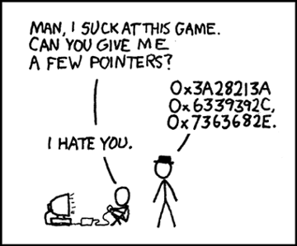
Returning Pointers
Source: http://www.xkcd.com/138

Slide 70
Example Function that Returns Pointer
char *strdup(const char *s);
strdup creates a copy of the string (char array) passed as arguments
  copy is created in dynamically allocated memory block of sufficient size
returns a pointer to the copy created
C does not allow returning an Array of any type from a function
  But we can use a pointer to simulate return of an array (or multiple values of same type)

Slide 71
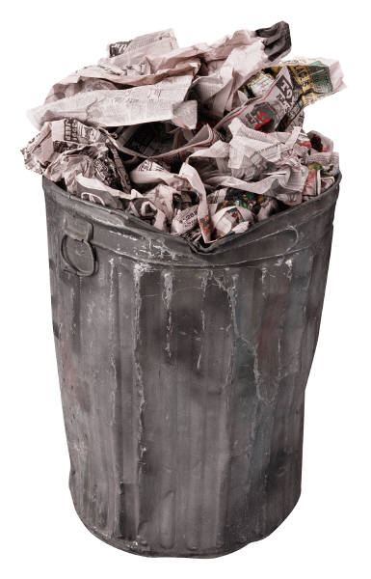
Returning Pointer: Beware
#include<stdio.h>
int *fun();
int main() {
printf("%d",*fun());
}
int *fun() {
int *p, i;
p = &i;
i = 10;
return p;
}
#include<stdio.h>
int *fun();
int main() {
printf("%d",*fun());
}
int *fun() {
int *p;
p = (int*)malloc(sizeof(int));
*p = 10;
return p;
}
OUTPUT: 10
OUTPUT

Slide 72
Returning Pointer: Beware
The function stack (except for the return value) is gone once the function completes its execution.
  All addresses of local variables and formal arguments become invalid
  available for “reuse”
But the heap memory, once allocated, remains until it is explicitly “freed”
  even beyond the function that allocated it.
addresses of static and global variables remain valid throughout the program.

Slide 73
An Intuition
Think of executing a function as writing on a classroom blackboard.
Once the function finishes execution (the class is over), everything on the blackboard is erased.
What if we want to retain a message, after class is over?
Solution could be to post essential information on a “notice board”, which is globally accessible to all classrooms.
The blackboard of a class is like the stack (possibly erased/overwritten in the next class), and the notice board is like the heap.

Slide 74
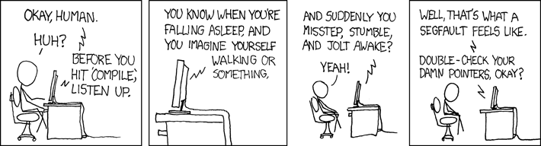
Common Issues and Errors
Source: http://www.xkcd.com/371

Slide 75
Common Issues and Errors
Forgetting to malloc, forgetting to initialize allocated memory
Not allocating enough space in malloc (e.g. Allocating 4 characters instead of 5 to store the string “IITK”.)
Returning pointers to temporaries (called dangling pointers)
Forgetting to free memory after use (called a memory leak.)
Freeing the same memory more than once (runtime error), using free-d memory

Slide 76
Memory Leaks
Consider code:
Memory is allocated to a at line 2.
However, at line 3, a is reassigned NULL
No way to refer to allocated memory!!
  We can not even free it, as free-ing requires passing address of allocated block
This memory is practically lost for the program (Leaked)
  Ideally, memory should be freed before losing last reference to it
1. int *a;
2. a = (int *)malloc(5*sizeof(int));
3. a = NULL;

Slide 77
Multi-dimensional Array vs. Multi-level pointer
Are these two equivalent?
  Both a and b can hold 6 integer in a 2x3 grid like structure.
  In case of a all 6 cells are consecutively allocated. For b, we have 2 blocks of 3 consecutive cells each.
int a[2][3];
int **b;
b = (int**)malloc(2*sizeof(int*));
b[0] = (int*)malloc(3*sizeof(int));
b[1] = (int*)malloc(3*sizeof(int));

Slide 78
Memory layout
int **b;
b = (int**)malloc(2*sizeof(int*));
b[0] = (int*)malloc(3*sizeof(int));
b[1] = (int*)malloc(3*sizeof(int));
int a[2][3];
b[0]
a
b
b[1]
Logical Layout
b[0] b[1]
b
a
Possible Physical Layout

Slide 79
Indexing Elements
b[0][1]
How do refer to an element
of the array in the language
of pointers?
b[0][1] is *(*b+1)
b[1][0] is **(b+1)
b[1][2] is *(*(b+1)+2)
In general, b[i][j] is *(*(b+i)+j)
b[0]
b
b[1]
b[1][0]
b[1][2]
b[0]
Expression Value
**(b+1)
*(*b+1)
(**b+1)
*(*b+2)+2
*(*(b+1)+2)+2
1
4
9
20
4
2
b
20
30
40
11
b[1]
42

Slide 80
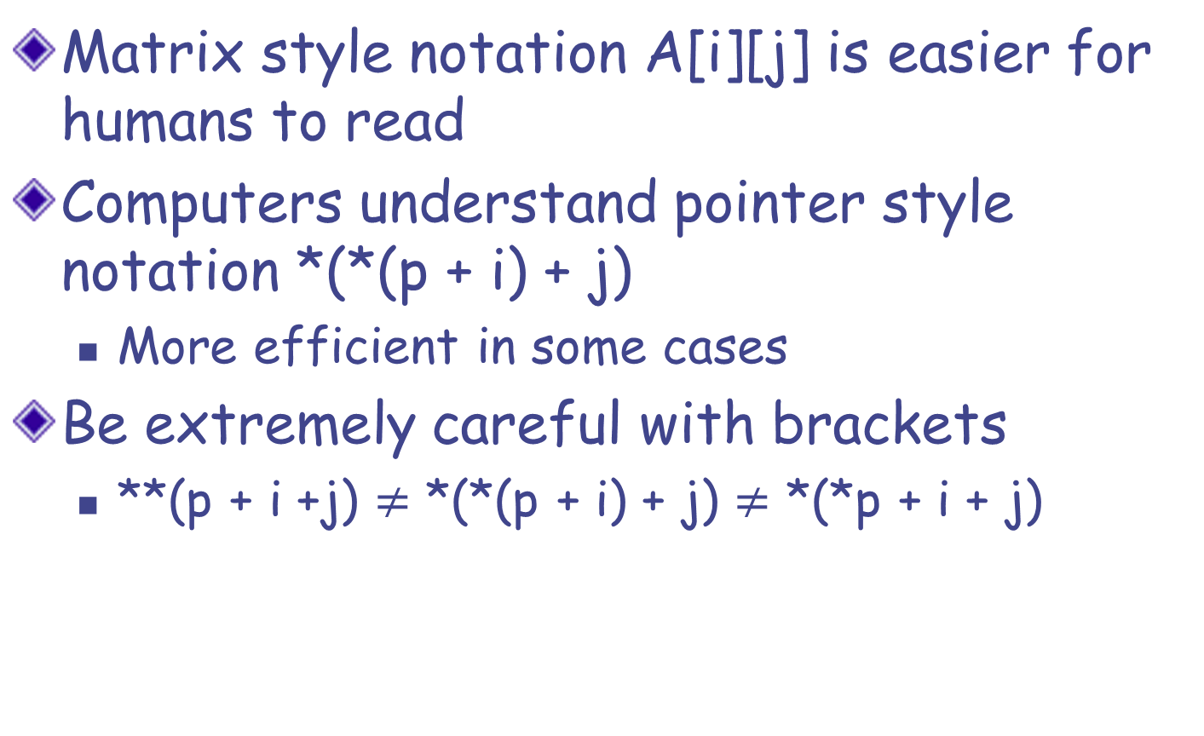
Pointers vs. Arrays: Indexing
Matrix style notation A[i][j] is easier for humans to read
Computers understand pointer style notation *(*(p + i) + j)
  More efficient in some cases
Be extremely careful with brackets
  **(p + i +j) $≠$ *(*(p + i) + j) $≠$ *(*p + i + j)

Slide 81
int a[3][3], i, j, *b, *c;
for (i=0; i<3; i++)
for (j=0; j<3; j++)
a[i][j] = pow((i+3),(j+1));
b = *a;
c = *(a+2);
for (i=0; i<3; i++)
printf("%d ", b[i]);
printf("\n");
for (i=0; i<3; i++)
printf("%d ", *(c+i));
At this point,
array a is:
3 | 9 | 27
4 | 16 | 64
5 | 25 | 125
What do b and c point-to here?
b is a pointer to
a[0][0]?
c is a pointer to
a[2][0]?
OUTPUT
3 9 27
5 25 125

Slide 82
int a[3][3], i, j, *b, *c;
for (i=0; i<3; i++)
for (j=0; j<3; j++)
a[i][j] = pow((i+3),(j+1));
b = *a;
c = *(a+2) + 1;
for (i=0; i<3; i++)
printf("%d ", b[i]);
printf("\n");
for (i=0; i<2; i++)
printf("%d ", *(c+i));
At this point,
array a is:
3 | 9 | 27
4 | 16 | 64
5 | 25 | 125
What do b and c point-to here?
b is a pointer to
a[0][0]?
c is a pointer to
a[2][1]?
OUTPUT
3 9 27
25 125
note
the
change

Slide 83
Array of Pointers vs. Pointer to an Array
int arr[2][3];
(number of rows fixed,
number of columns fixed)
int (*arr)[3];
(only the number of columns fixed)
.
.
.
Array of arrays
int* arr[3];
(only the number of rows fixed)
int **arr;
(general case)

Slide 84
int **a; *b[2]; (*c)[3]; d[2][3];
c = d; /* Fine, matches the column size */
c = b; /* Warning: incompatible pointer type */
printf("sizeof(a) = %3d, sizeof(*a) = %3d, sizeof(**a) = %3d\n",
sizeof(a), sizeof(*a), sizeof(**a));
printf("sizeof(b) = %3d, sizeof(*b) = %3d, sizeof(**b) = %3d\n",
sizeof(b), sizeof(*b), sizeof(**b));
printf("sizeof(c) = %3d, sizeof(*c) = %3d, sizeof(**c) = %3d\n",
sizeof(c), sizeof(*c), sizeof(**c));
printf("sizeof(d) = %3d, sizeof(*d) = %3d, sizeof(**d) = %3d\n",
sizeof(d), sizeof(*d), sizeof(**d));
sizeof(a) = 8, sizeof(*a) = 8, sizeof(**a) = 4
sizeof(b) = 16, sizeof(*b) = 8, sizeof(**b) = 4
sizeof(c) = 8, sizeof(*c) = 12, sizeof(**c) = 4
sizeof(d) = 24, sizeof(*d) = 12, sizeof(**d) = 4

